Slide 1
Real Estate and Machine Learning
Graham Latsa and Uday Datta

Slide 2
Introduction / Objective
We wanted to leverage Machine Learning in a real estate application
Specifically can we use features such as Median Price, Total Viewings, Square Footage to classify a house?
Notes:
Graham

Slide 3
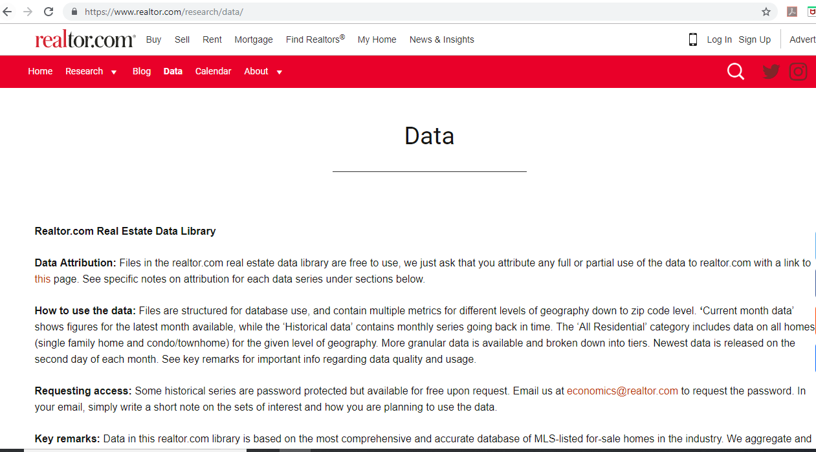
DATASET
We obtained data from the national association of realtors specifically the data centered residential housing (broken up by # of rooms]
Data included pricing, size, and listing information such as active listings, views, etc.
Some of data had to be cleaned and dropped – we ultimately worked with 6251 records from the month of April 2019
Training set – 4167
Test set – 2084
Notes:
Uday

Slide 4
Project Approach
We Examine the following Model tYPEs:
Decision Trees
Niave Bayes
KNN
SVM
RF
Based on a cross validation of 10 folds and repeated 3 times with default parameters
Notes:
Uday

Slide 5
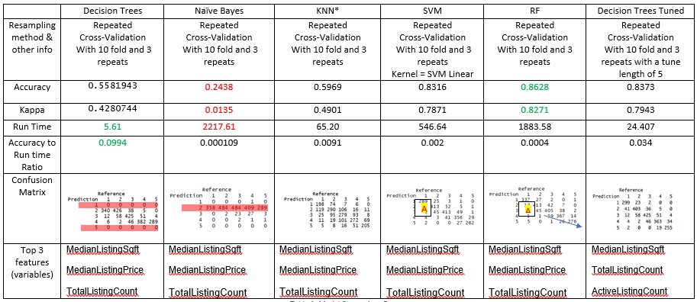
Results
Notes:
Uday

Slide 6
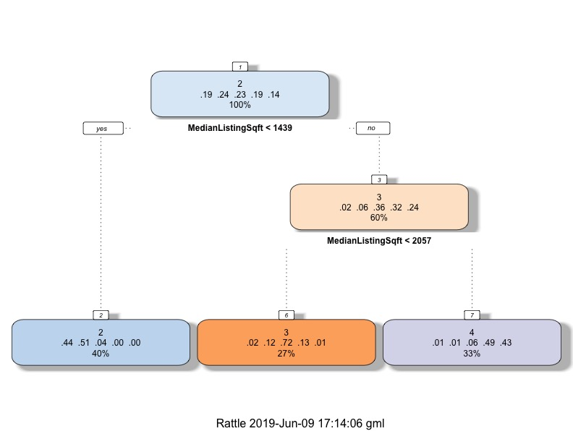
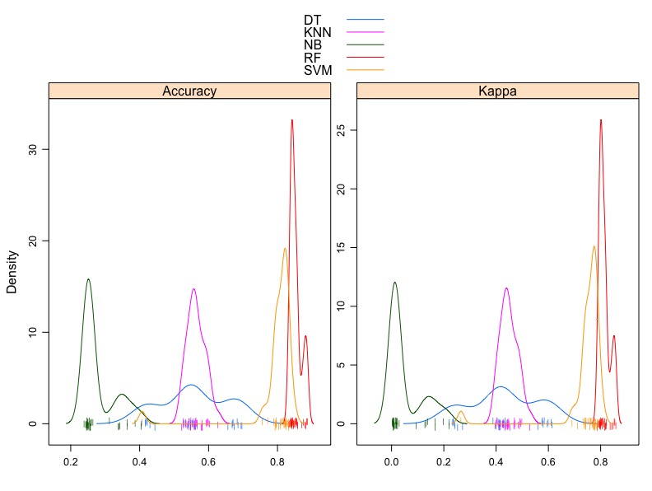
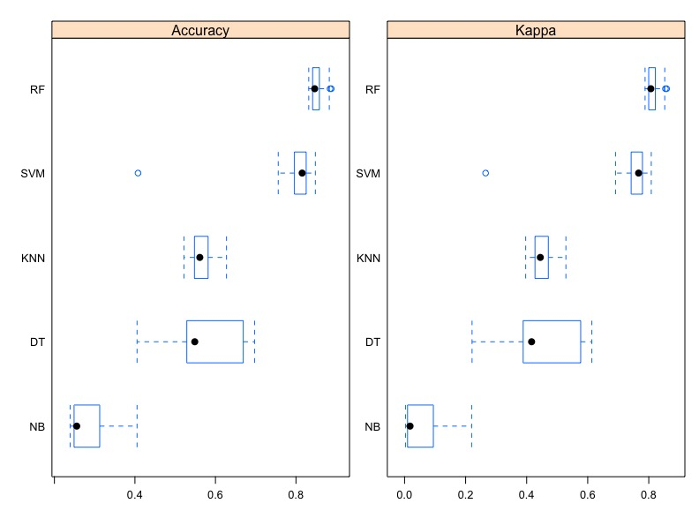
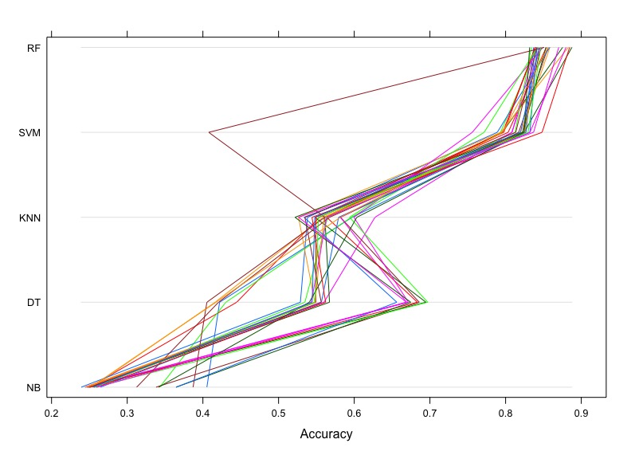
Results - Visualized
Notes:
Graham

Slide 7
Conclusion and Lessons Learned
there’s a trade-off between accuracy, speed, and complexity
Ultimately we would select the SVM algorithm due to it’s speed and accuracy and customization (parameters)
Notes:
Graham

